Slide 1
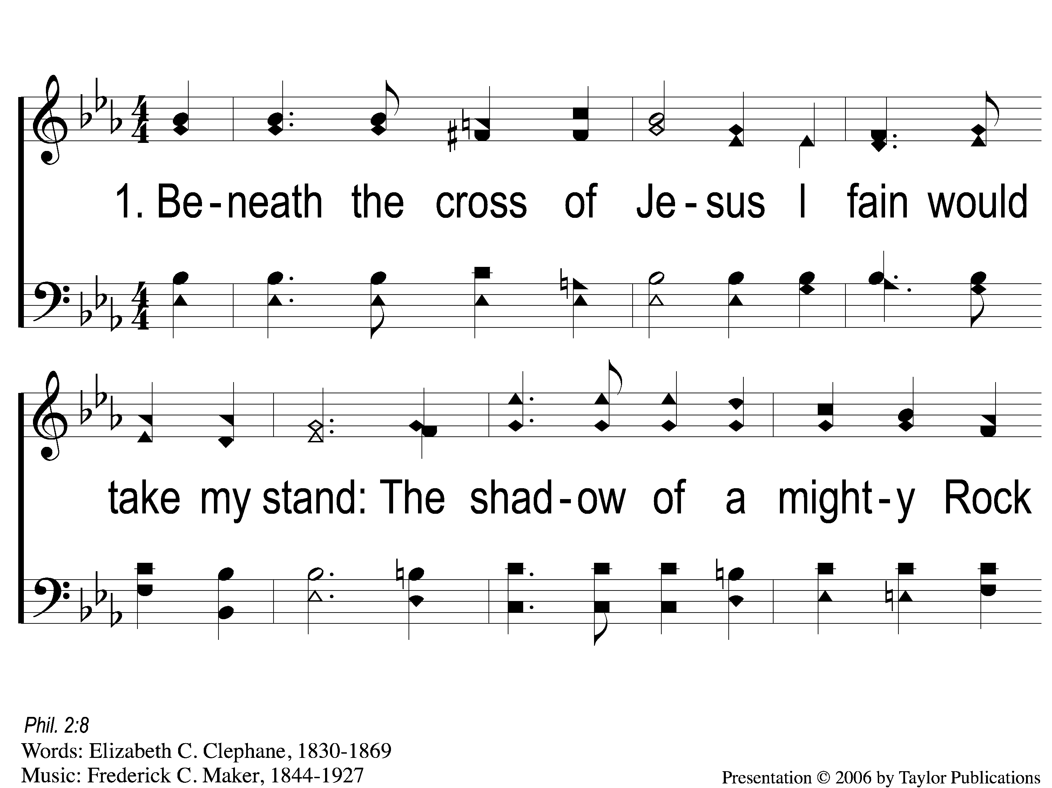
1-1 Beneath the Cross of Jesus
Beneath the Cross of Jesus
38

Slide 2
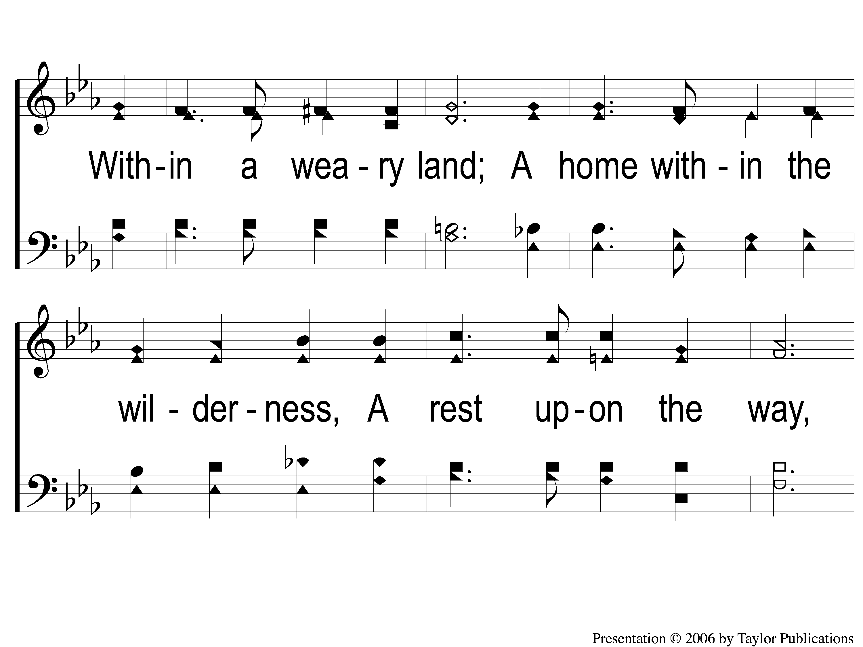
1-2 Beneath the Cross of Jesus
Beneath the Cross of Jesus
38

Slide 3
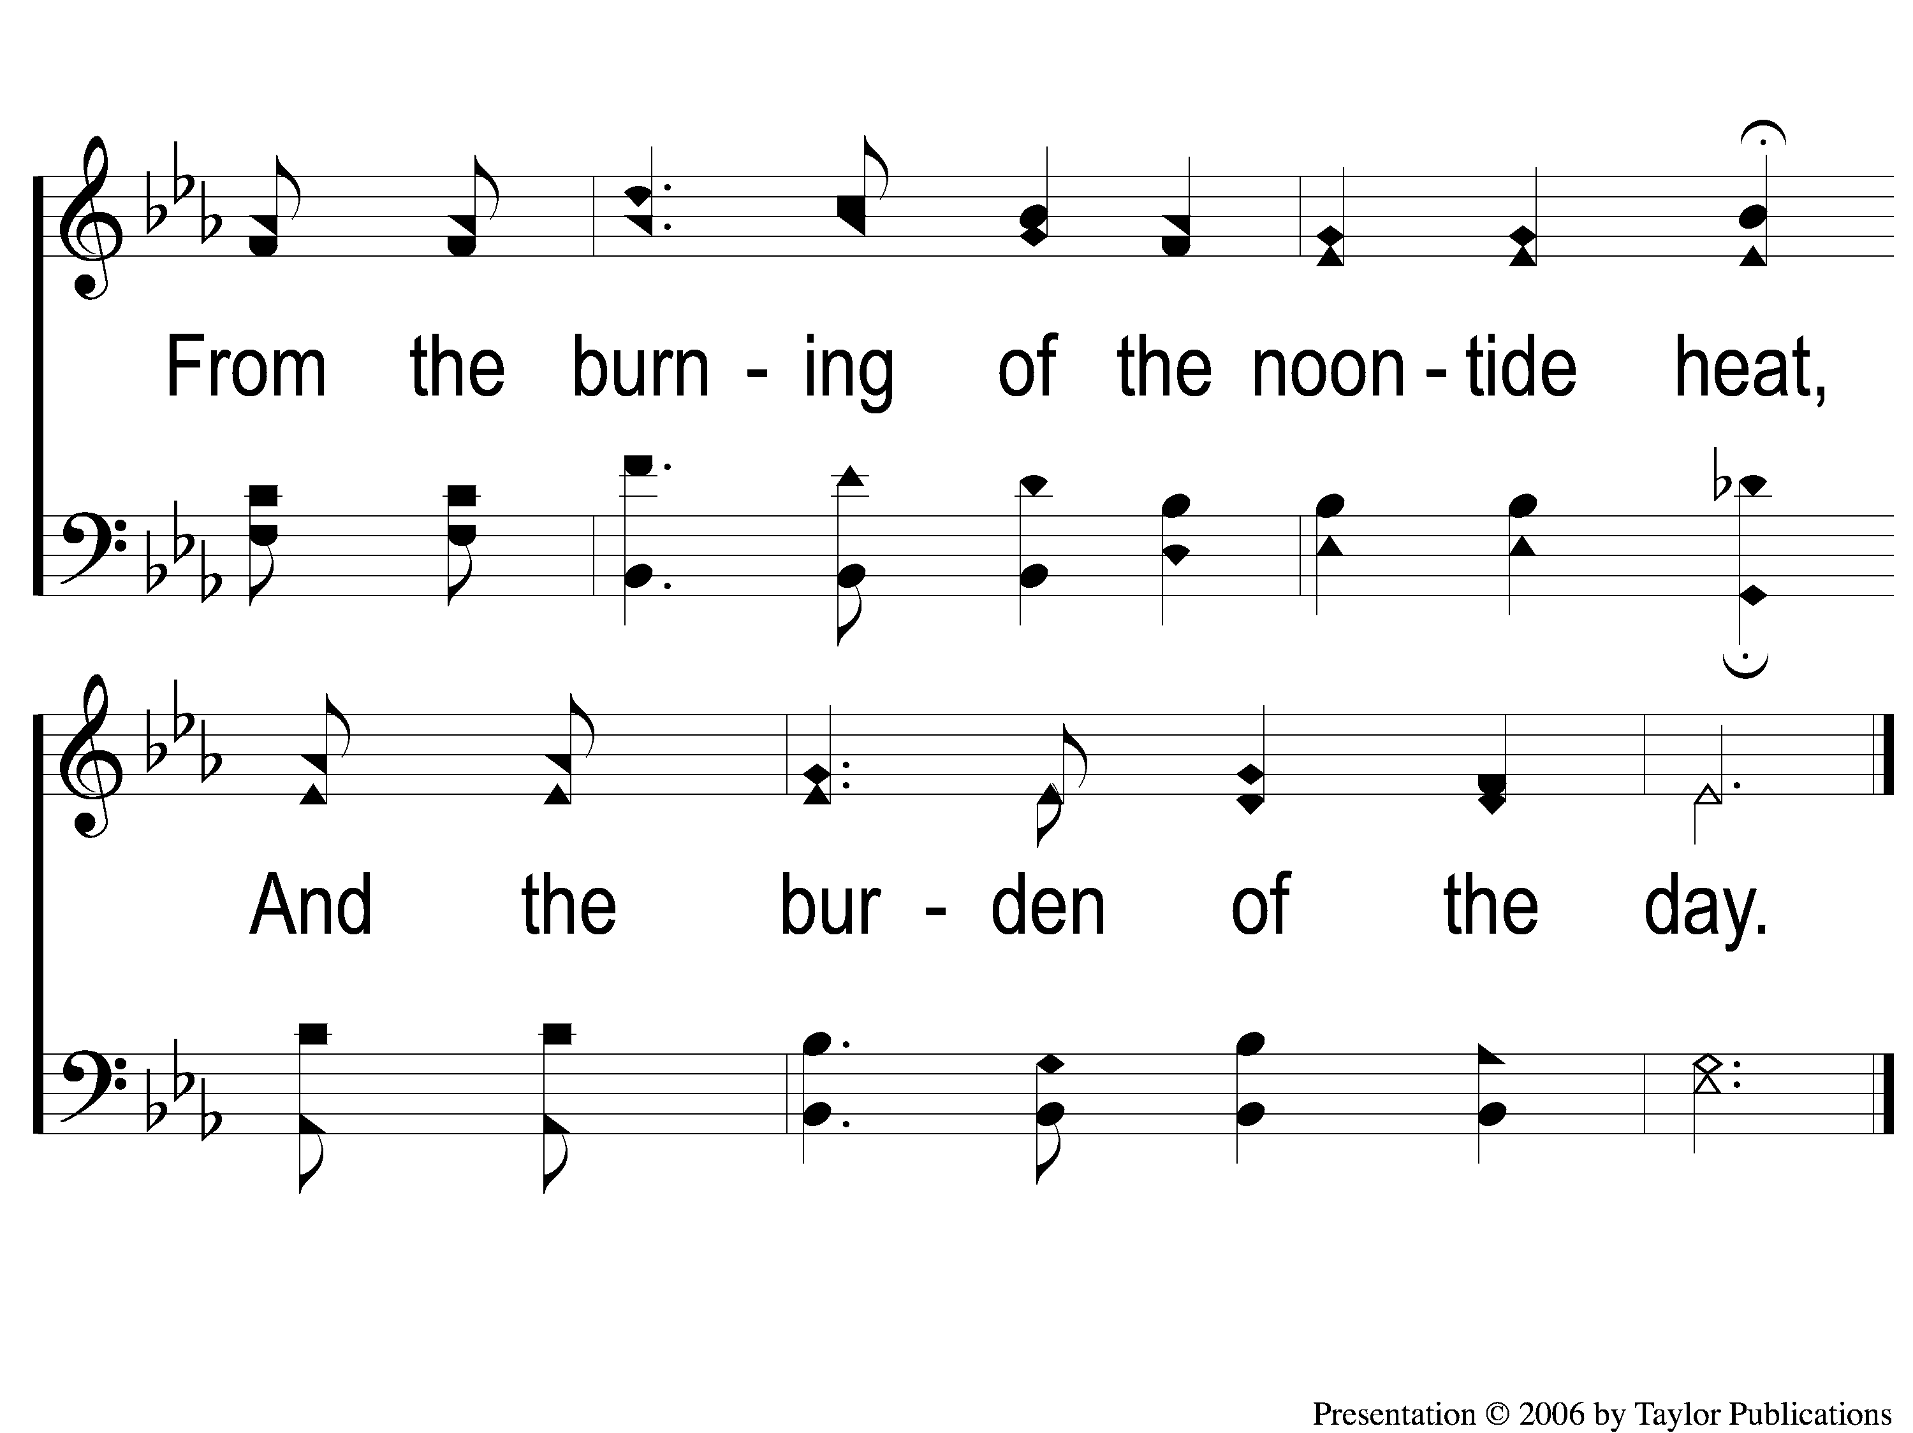
1-3 Beneath the Cross of Jesus
Beneath the Cross of Jesus
38

Slide 4
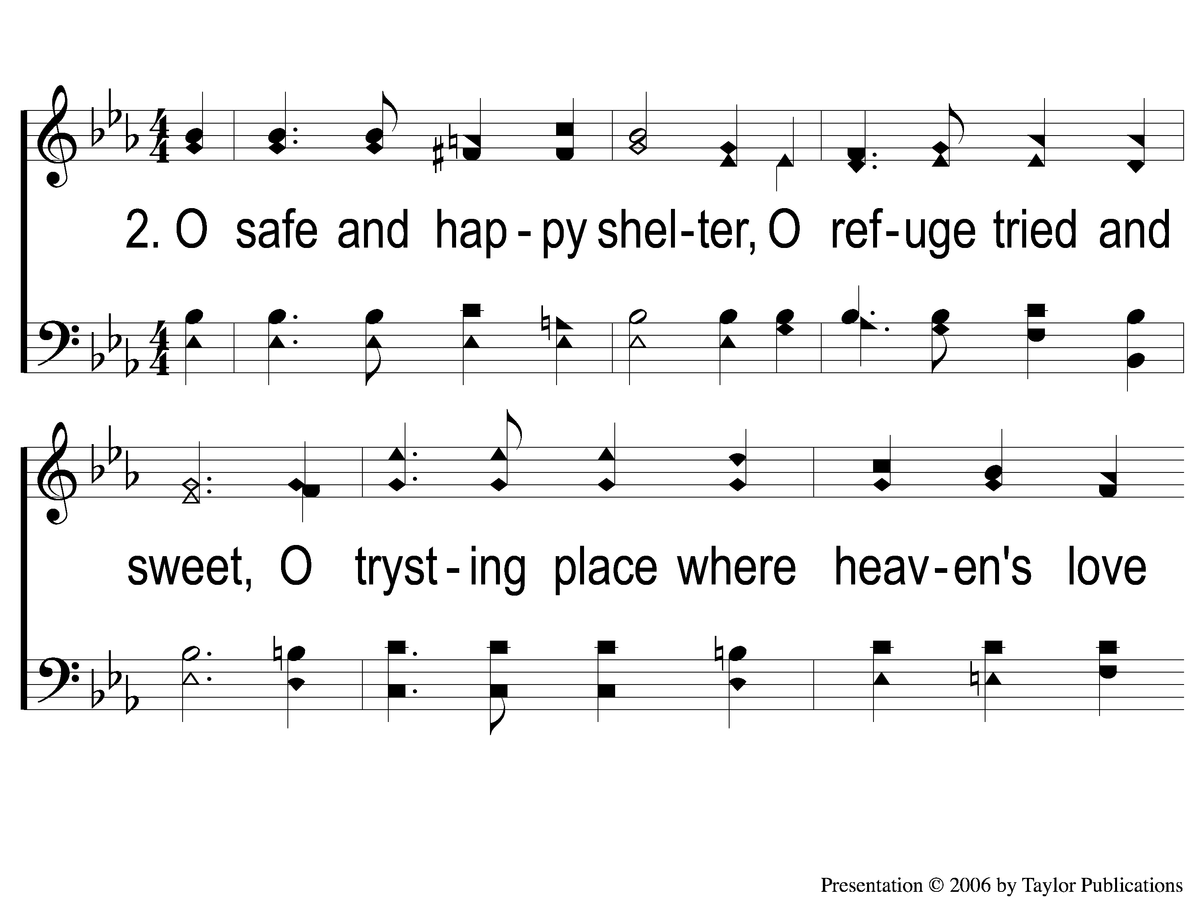
2-1 Beneath the Cross of Jesus
Beneath the Cross of Jesus
38

Slide 5
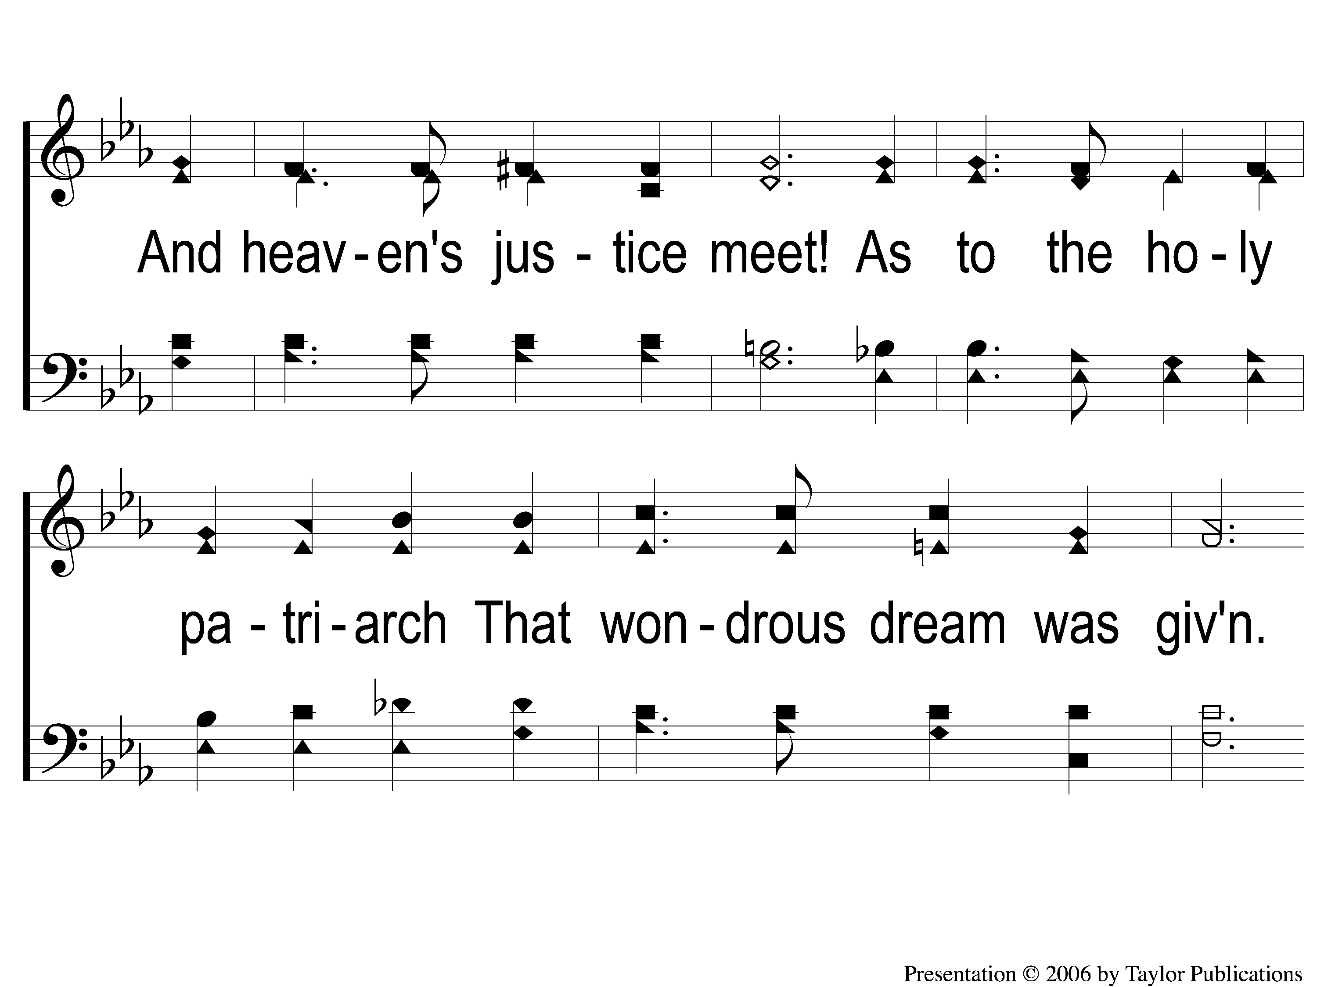
2-2 Beneath the Cross of Jesus
Beneath the Cross of Jesus
38

Slide 6
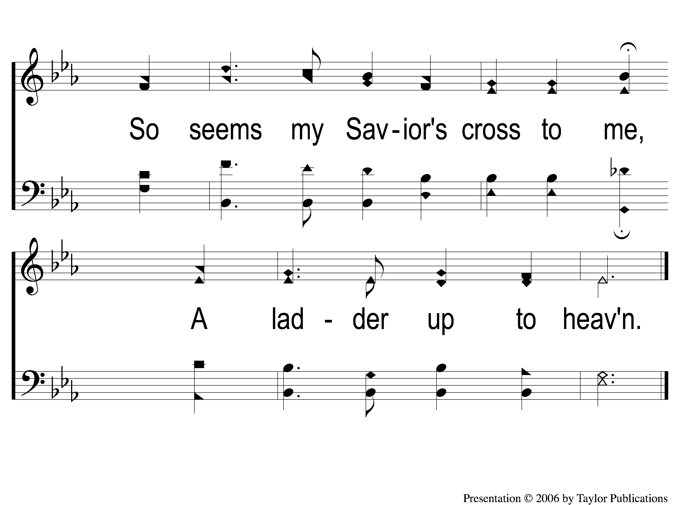
2-3 Beneath the Cross of Jesus
Beneath the Cross of Jesus
38

Slide 7
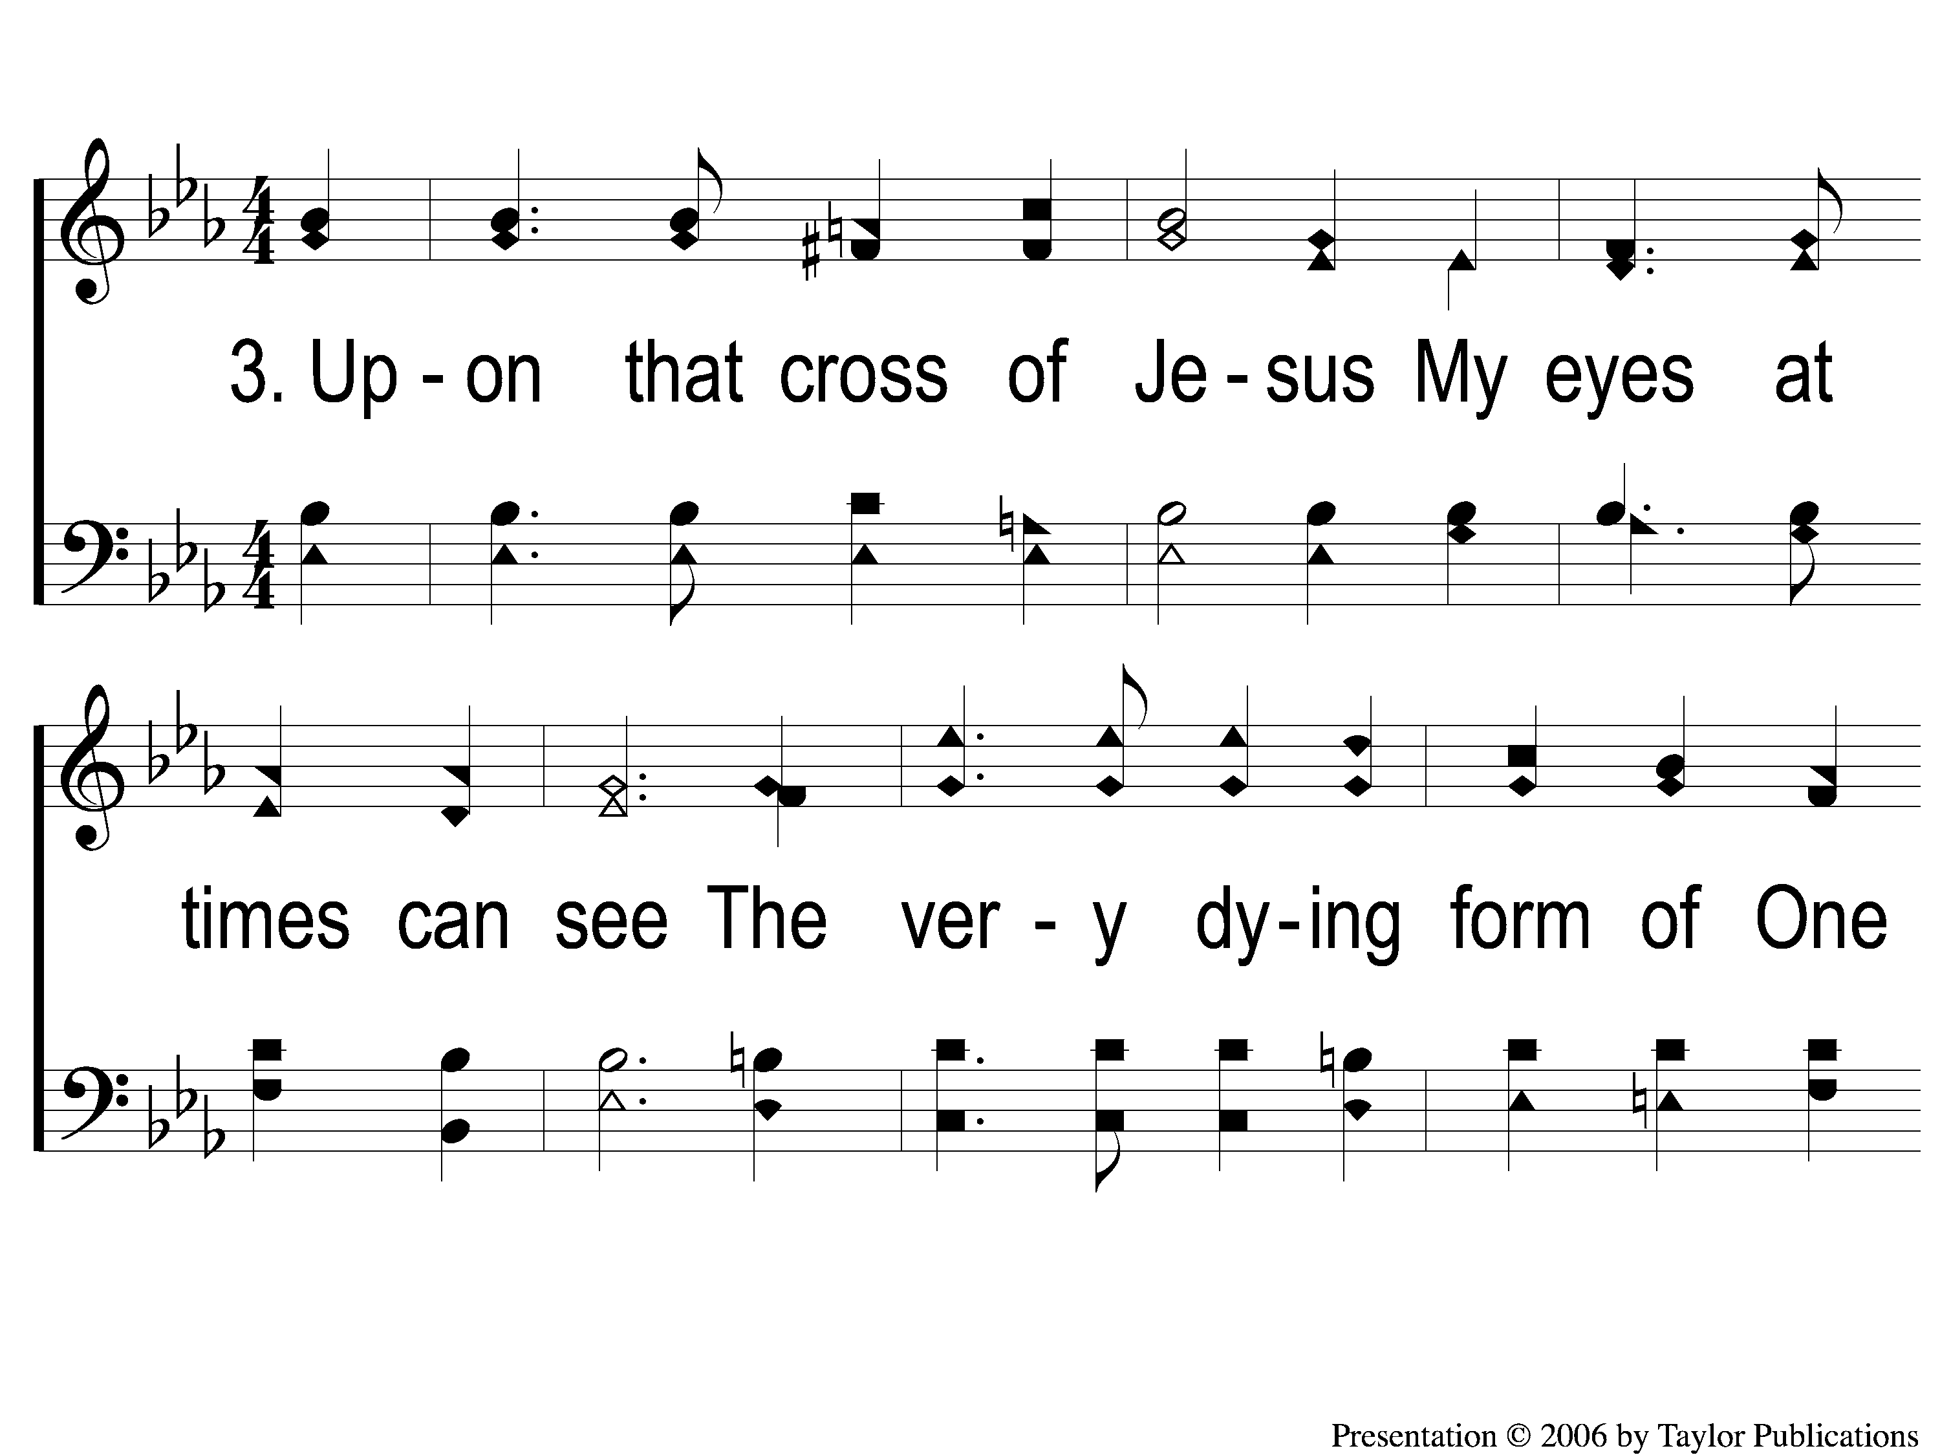
3-1 Beneath the Cross of Jesus
Beneath the Cross of Jesus
38

Slide 8
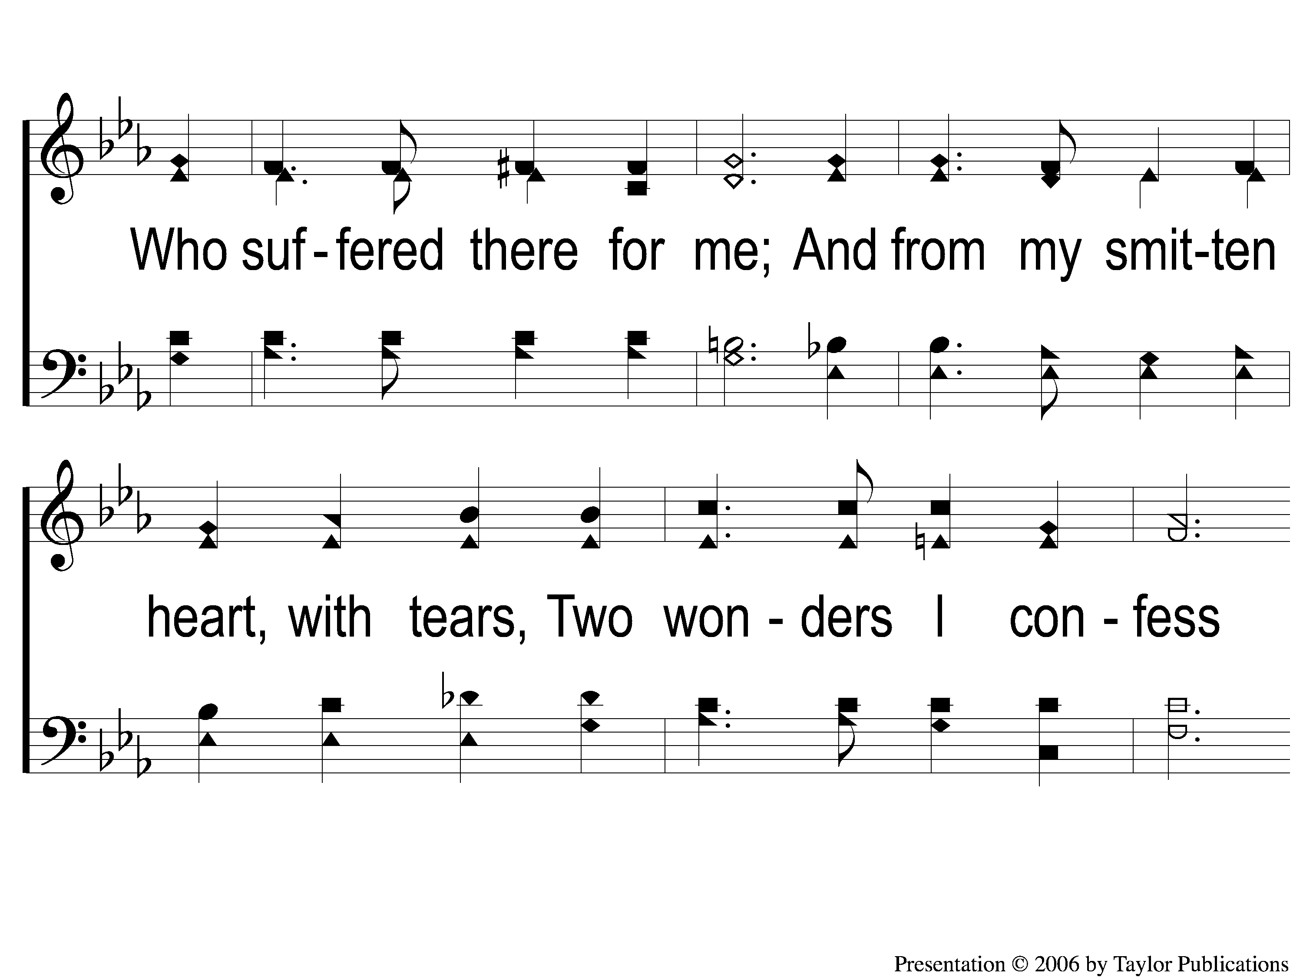
3-2 Beneath the Cross of Jesus
Beneath the Cross of Jesus
38

Slide 9
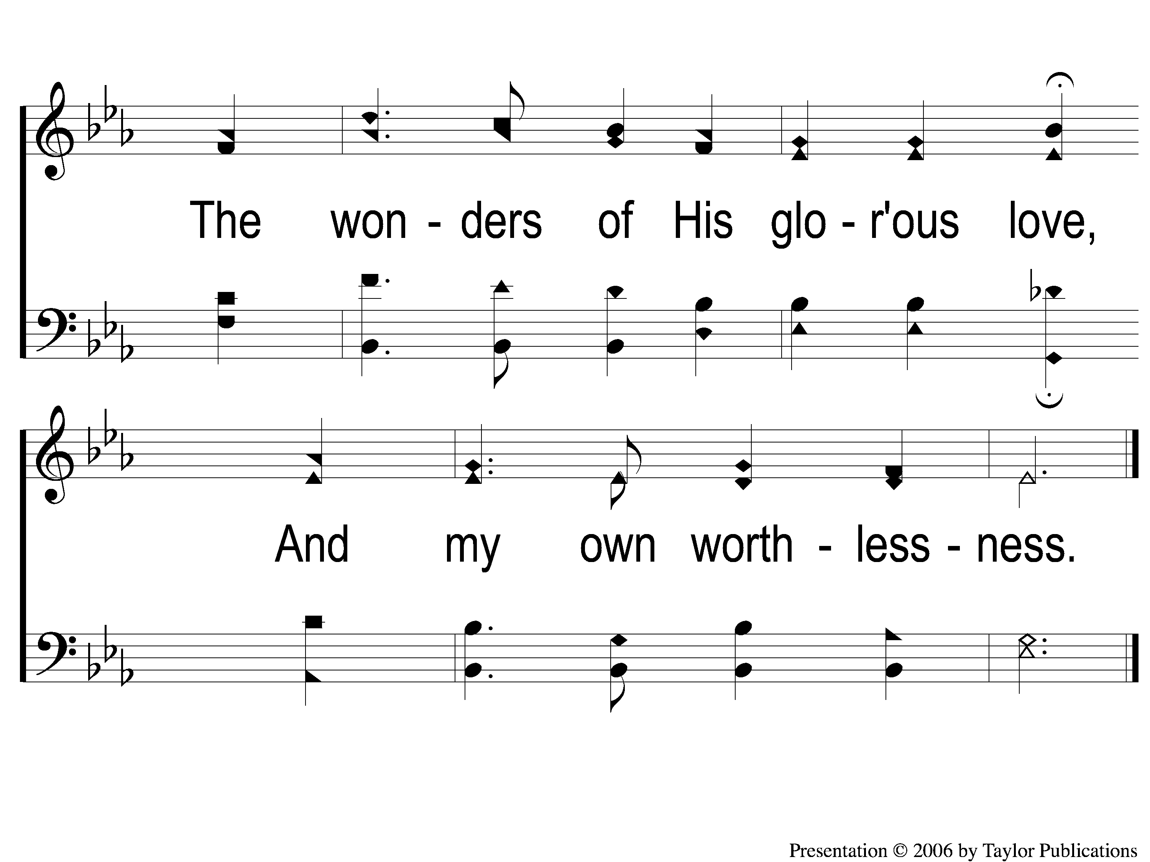
3-3 Beneath the Cross of Jesus
Beneath the Cross of Jesus
38

Slide 10
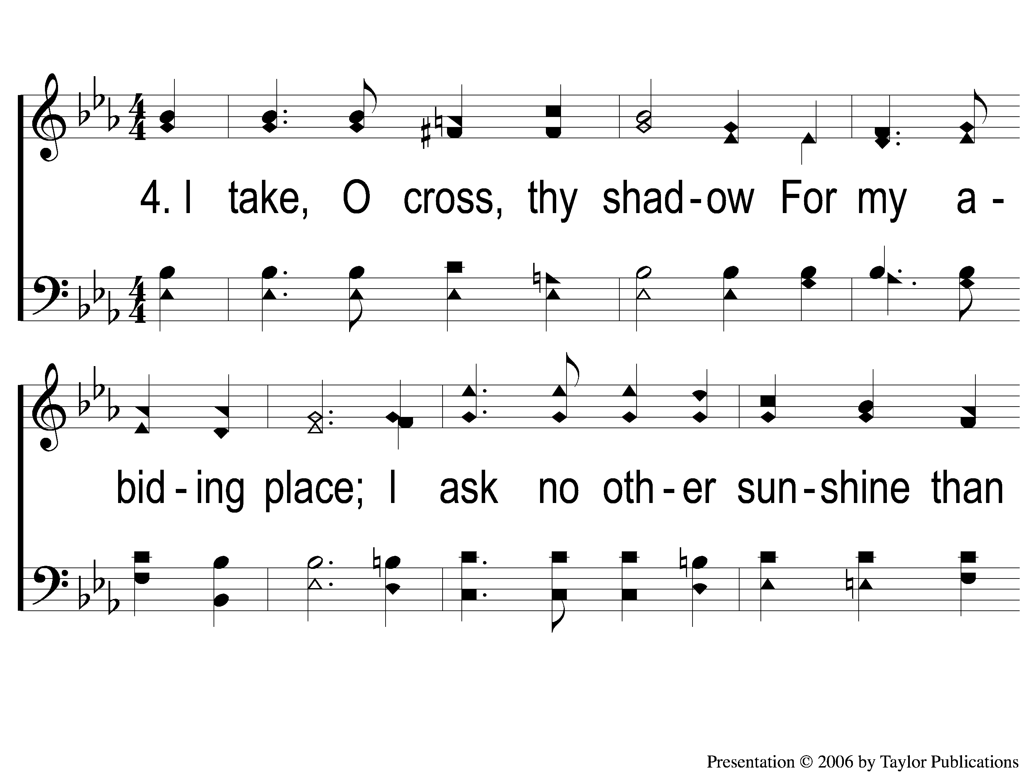
4-1 Beneath the Cross of Jesus
Beneath the Cross of Jesus
38

Slide 11
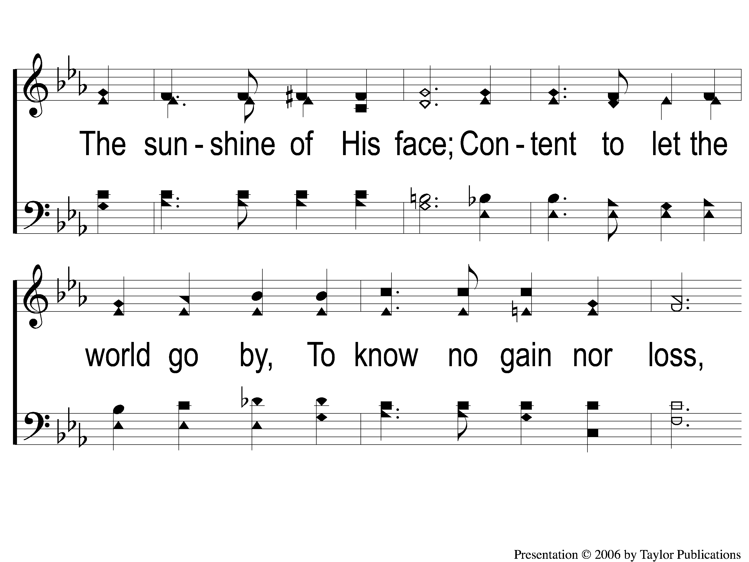
4-2 Beneath the Cross of Jesus
Beneath the Cross of Jesus
38

Slide 12
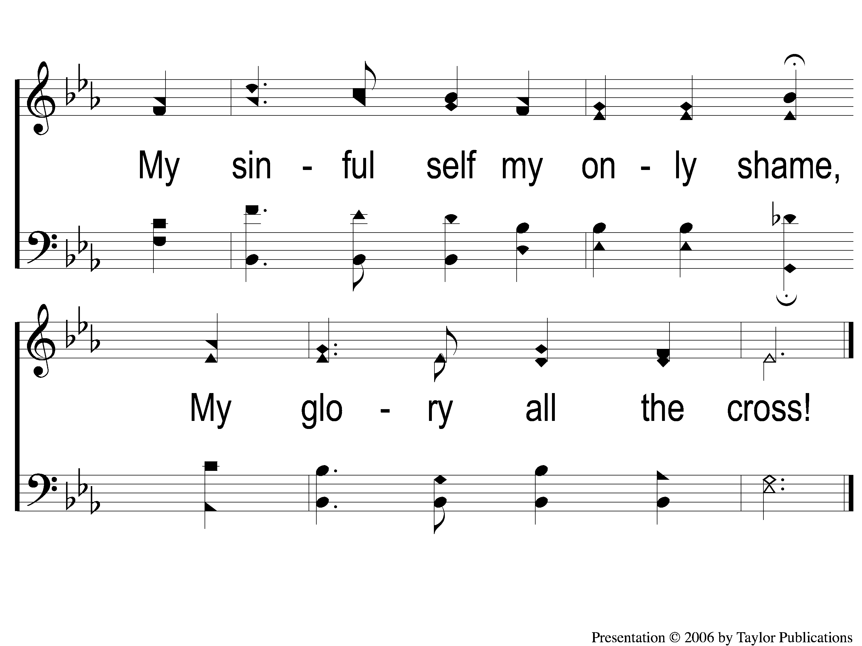
4-3 Beneath the Cross of Jesus
Beneath the Cross of Jesus
38

